Slide 1
به نام خدا

Slide 2
Cyclic antidepressants Dr.Ali Ostadi Associate Professor of Forensic Medicine and Toxicology Fellowship of clinical toxicology &poisoning Department of Internal Medicine Tabriz University of Medical Sciences

Slide 3
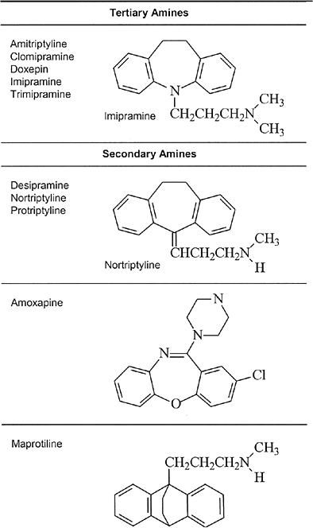
Dr.Ali Ostadi Associate Professor of Forensic Medicine and Toxicology Fellowship of clinical toxicology &poisoning Department of Internal Medicine Tabriz University of Medical Sciences

Slide 4
HISTORY AND EPIDEMIOLOGY used in the treatment of depression, neuropathic pain, migraines, enuresis, and attention deficit hyperactivity disorder. From the 1960s until the late 1980s, the tricyclic antidepressants (TCAs) represented the major pharmacologic treatment for depression in the United States.

Slide 5
PHARMACOLOGY inhibit the presynaptic reuptake of norepinephrine and/or serotonin and thus functionally increase the amount of these neurotransmitters at central nervous system (CNS) receptors.

Slide 6
• Inhibition of presynaptic neurotransmitter reuptake (norepinephrine and serotonin) • Blockade of cardiac fast sodium channels • Antagonism of central and peripheral muscarinic acetylcholine receptors • Antagonism of peripheral alpha-1 adrenergic receptors • Antagonism of histamine (H1) receptors • Antagonism of CNS gamma-aminobutyric acid (GABA) A receptors

Slide 7
PHARMACOKINETICS AND TOXICOKINETICS rapidly and almost completely absorbed from the gastrointestinal tract, with peak concentrations 2–8 hours after administration of a therapeutic dose

Slide 8
Elimination half-lives for therapeutic doses of CAs vary from 7–58 hours (54–92 hours for protriptyline), with even longer half-lives in the elderly. Finally, less than 5% of CAs are excreted by the kidney unchanged

Slide 9
Highly lipophilic Readily crosses blood-brain barrier Peak levels occur 2-6 hours post ingestion Decreased gut motility may prolong absorption Highly protein bound Tissue levels up to 100 times plasma level Only 1-2% total-body TCA in plasma

Slide 10
Hemodialysis, hemoperfusion and forced diuresis are ineffective Hepatic metabolization Renal excretion Most have active metabolites Toxicity from tertiary TCA’s last longer than secondary TCA’s Half life Therapeutic: on average 24 hours Overdose: up to 72 hours

Slide 11
PATHOPHYSIOLOGY The CAs block the rapid inward movement of sodium ions into the fast sodium channel

Slide 12
All TCA’s structurally similar Many have active metabolites Multiple toxicologic effects Antihistaminic Anticholinergic α adrenergic blockade Sodium channel blockage GABA-A receptor antagonist

Slide 13
Antihistamine Effects Potent inhibitors of histamine receptors Manifested as CNS sedation Anticholinergic Effects Due to antimuscarinic receptor blockade ▪ Dilated pupils ▪ Blurred vision ▪ Dry skin ▪ Tachycardia ▪ Hypertension ▪ Hyperthermia ▪ Urinary retention ▪ Ileus ▪ Dry mouth ▪ Agitation ▪ Delirium ▪ Confusion ▪ Hallucinations ▪ Slurred speech ▪ Coma

Slide 14
α-Adrenergic Receptor Antagonism Inhibits both central and peripheral receptors Greater affinity for α₁ No β-blockade Effects - Sedation - Orthostatic hypotensio - Pupillary constriction ▪ Usually negated by antimuscarinic effect

Slide 15
Amine Uptake Inhibition Mechanism by which TCA’s are efficacious in depression In overdose likely produces early sympathomimetic effects including some dysrhythmias

Slide 16
Sodium Channel Blockade Quinidine-like effect Single-most important factor relating to mortality in TCA toxicity Inhibits fast sodium channels in His-Purkinje cells Impairs sodium entry into myocardial cells Prolongs depolarization (Phase 0), decreases contractility More pronounced effects with rapid heart rates, hyponatremia and acidosis

Slide 17
Sodium Channel Blockade Prolonged PR Widens QRS Right axis deviation - Manifested by terminal R-wave in aVR and S-wave in I Bradycardia - May be attenuated by antimuscarinic effect - Indicates profound sodium channel blockade

Slide 18
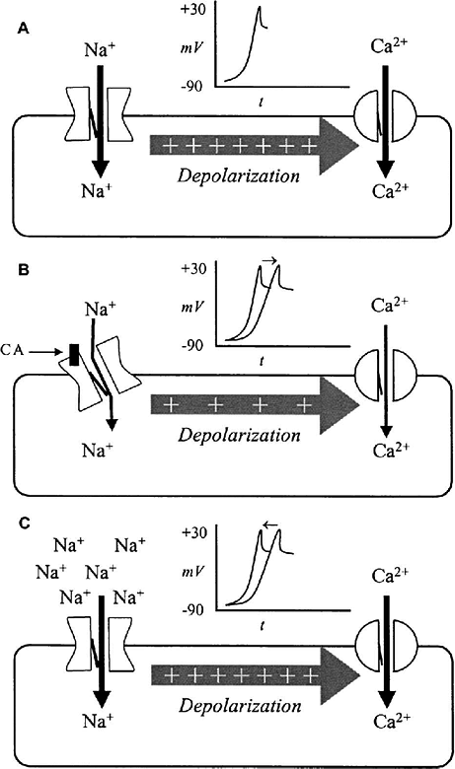

Slide 19
GABA-A Receptor Antagonist Major cause of seizure in TCA toxicity

Slide 20
Potassium Channel Blockade Prevents efflux during repolarization QT interval prolongation More pronounced with bradycardia Tachycardia prevents severe QT prolongation Torsades de pointes may develop, but is rare in TCA toxicity

Slide 21
CLINICAL MANIFESTATIONS OF TOXICITY

Slide 22
Acute Cardiovascular Toxicity prolongation of the QRS complex duration and rightward shift of the terminal 40-msec QRS axis (T40-ms) PR, QRS, and QTc

Slide 23
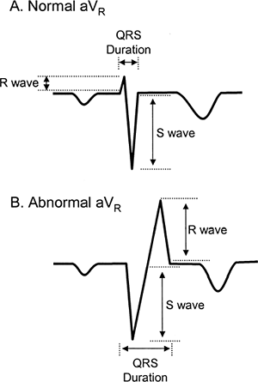

Slide 24
Acute Central Nervous System Toxicity Seizures and altered mental status Delirium, disorientation, agitation, and/or psychotic behavior with hallucinations

Slide 25
Anticholinergic and Other Clinical Toxicity Pupils may be dilated dry mouth, dry flushed skin, hyperthermia, urinary retention, and ileus.

Slide 26
DIAGNOSTIC TESTING

Slide 27
Electrocardiogram QRS interval of 100 msec or longer, 33% develop seizures. When the QRS duration prolongs to 160 msec, there is a 50% incidence of ventricular dysrhythmias

Slide 28
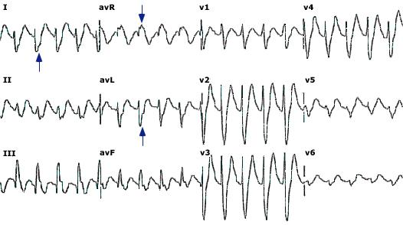
The QRS complex is prolonged with delayed right ventricular activation and intraventricular conduction delay, which results in rightward shift in the terminal 40 msec frontal plane QRS vector. In qualitative terms, this shift manifests as a deep, slurred S wave in leads I and AVL, and an R wave in lead AVR (blue arrows).

Slide 29
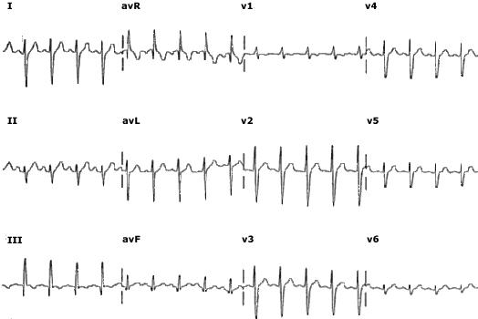
Following treatment with sodium bicarbonate, the intraventricular conduction delay resolves, and the QRS complex duration and morphology return to normal.

Slide 30
Laboratory

Slide 31
MANAGEMENT intubation cardiac monitor, intravenous access 12-lead ECG

Slide 32
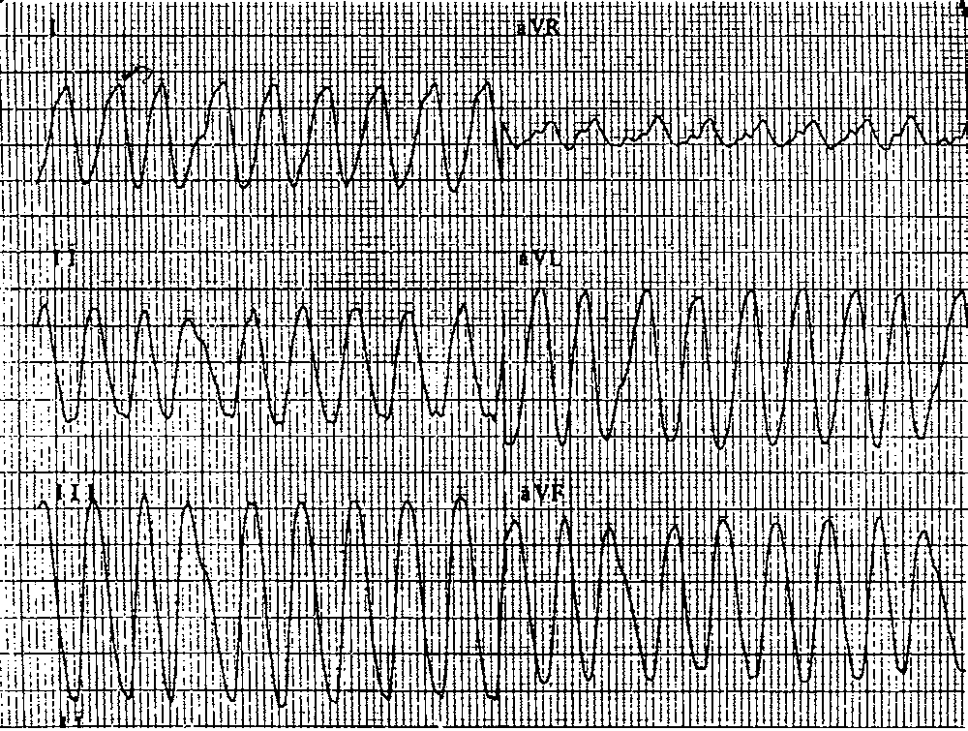

Slide 33
Gastrointestinal Decontamination Induction of emesis is contraindicated. Orogastric lavage should be considered Activated charcoal

Slide 34
Wide-Complex Dysrhythmias, Conduction Delays, and/or Hypotension serum alkalinization sodium bicarbonate hypertonic sodium chloride hyperventilation

Slide 35
sodium bicarbonate 1-2 mEq/kg Three 50-mL ampules should be placed in 1 L of 5% dextrose in water (D₅W) and run at twice maintenance

Slide 36
Antidysrhythmic Therapy lidocaine class IA (quinidine, procainamide, disopyramide, and moricizine) and class IC (flecainide, propafenone) antidysrhythmics are absolutely contraindicated

Slide 37
Hypotension isotonic saline inotropic vasopressor

Slide 38
Central Nervous System Toxicity flumazenil physostigmine Seizures Recurrent seizures, prolonged seizures Benzodiazepines barbiturates or propofol

Slide 39
Enhanced Elimination multiple doses of activated charcoal

Slide 40
Hospital Admission Criteria

Slide 41
?
Dr.Ali Ostadi Associate Professor of Forensic Medicine and Toxicology Fellowship of clinical toxicology &poisoning Department of Internal Medicine Tabriz University of Medical Sciences

Slide 42
END
Dr.Ali Ostadi Associate Professor of Forensic Medicine and Toxicology Fellowship of clinical toxicology &poisoning Department of Internal Medicine Tabriz University of Medical Sciences

